Slide 1

IWA19 CAPSTONE PROJECT
NOELEEN KYLIE MOODLEY
2023

Slide 2
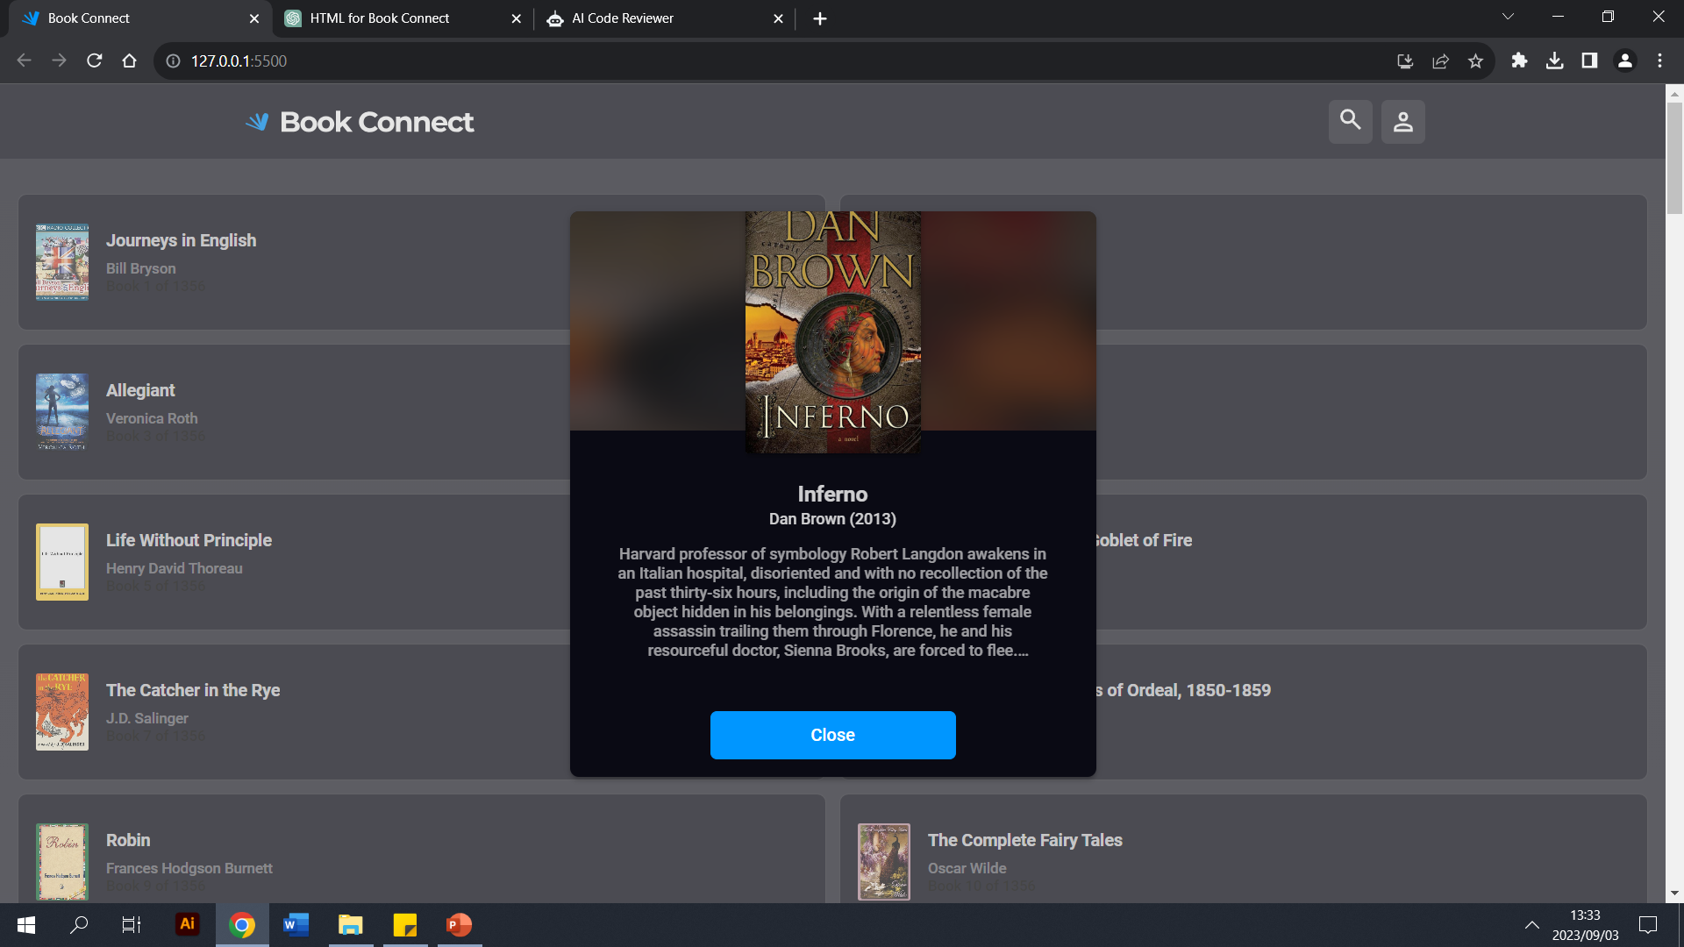
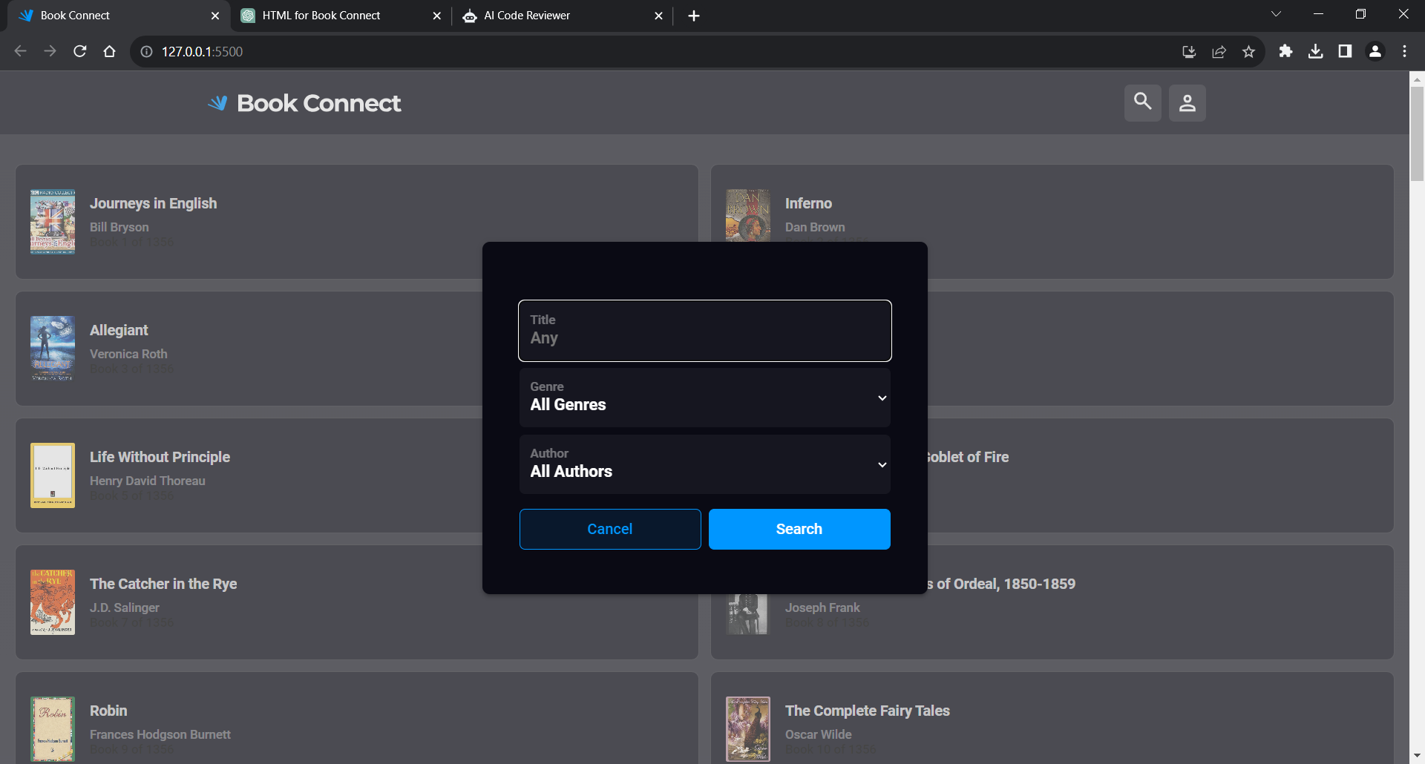
Introduction & Overview
The App aims to create a centralized platform for book-related information, offering an engaging and efficient way for users to explore, learn about, and engage with a diverse array of books and authors.
Key Features:
1. Book Listings and Details:
Users can browse through a diverse collection of books, presented in a user-friendly interface. Each book listing showcases the book's title, cover image, genre tags, popularity rating, and a concise description. Clicking on a book provides detailed information about the book.
2. Author Profiles:
The app highlights authors by providing dedicated profile pages that feature their names and a brief biography. Users can explore the works of specific authors and navigate to those books
3. Genre Categorization:
Books are categorized into various genres, allowing users to filter and discover books based on their interests.
4. Search and Filtering:
Users can search for books, authors, and genres using a robust search functionality and filter options
5.Pagination:
There are a manageable number of books per page to handle large volumes of books
6. User Interaction:
Users can rate and review and save books, and leave comments on author profiles.
7. Responsive Design:
The app is designed to be responsive, ensuring a seamless experience across different devices

Slide 3
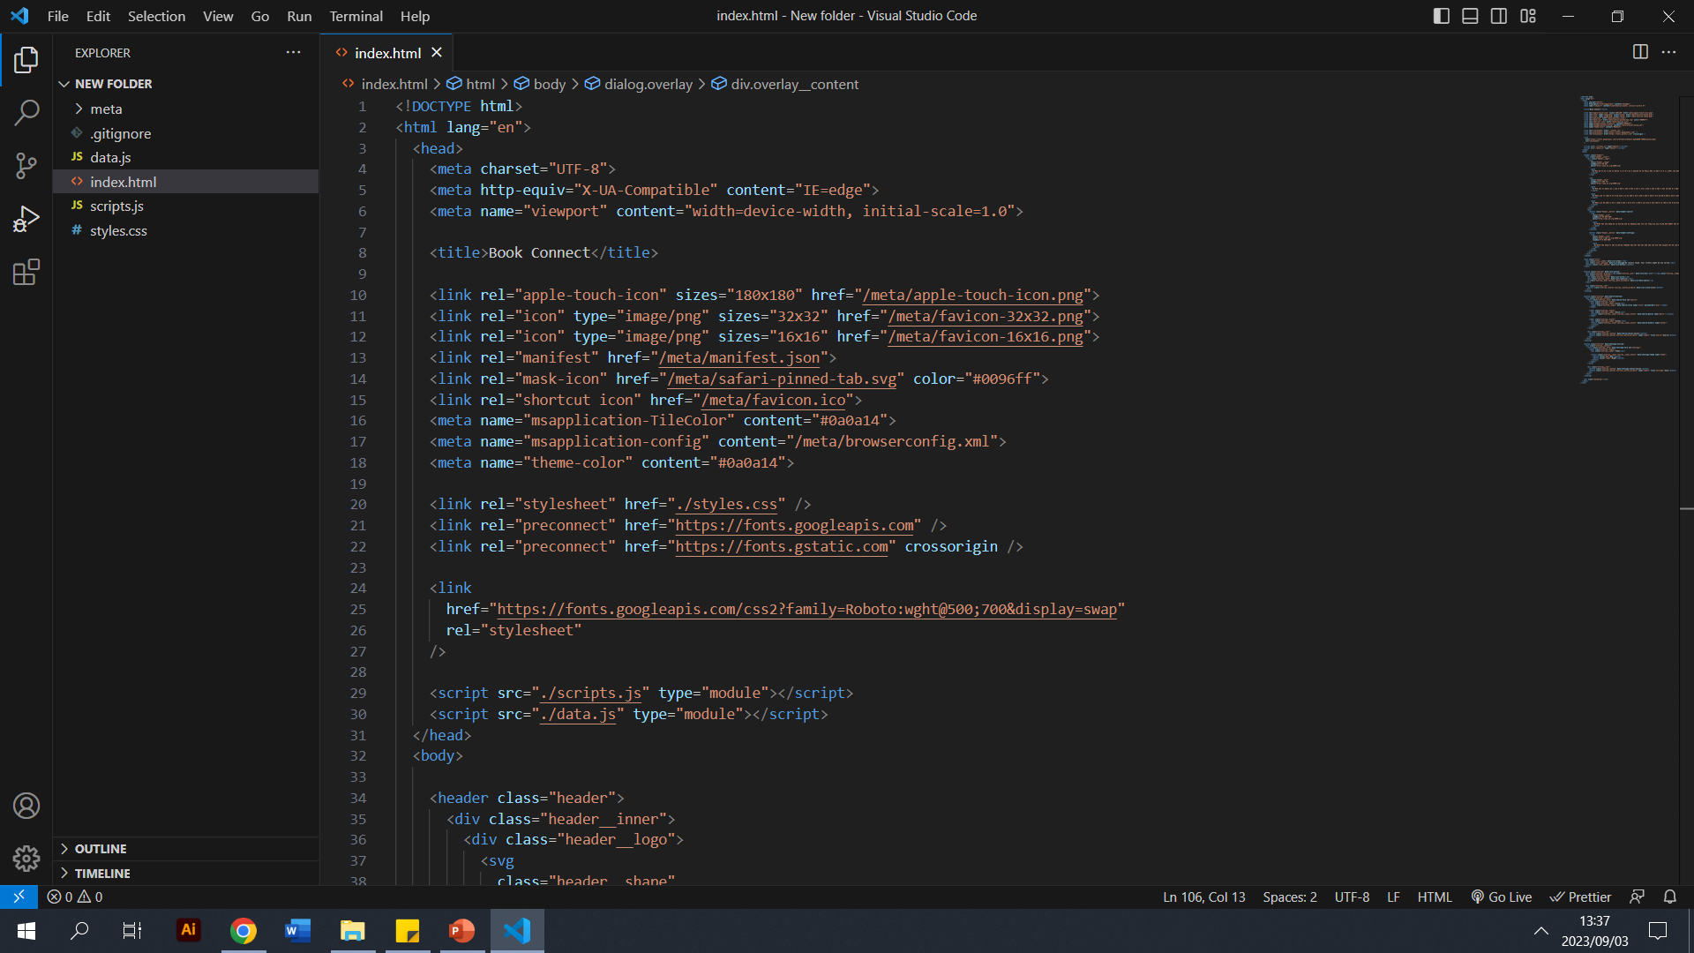
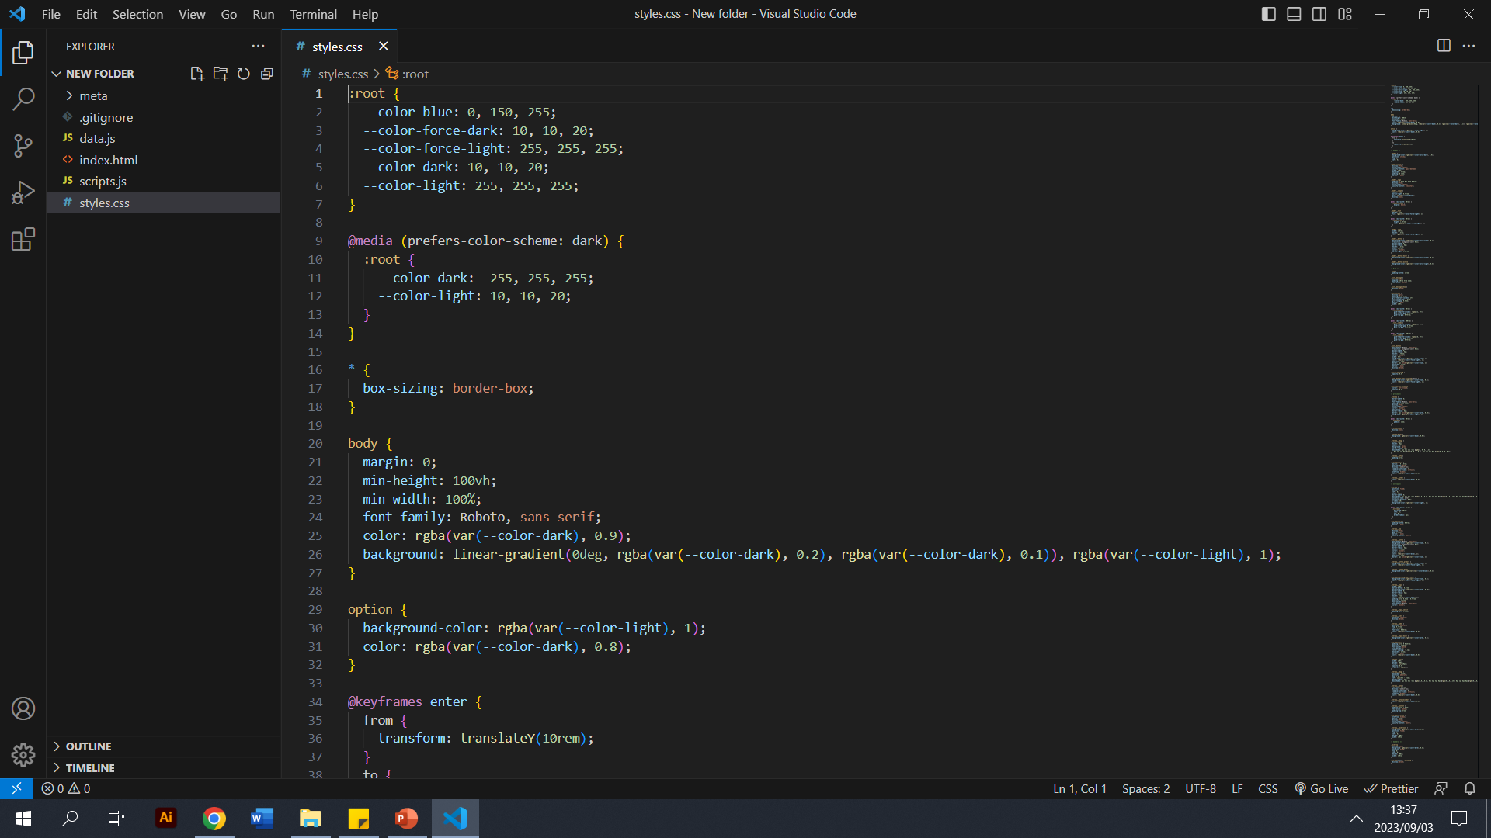
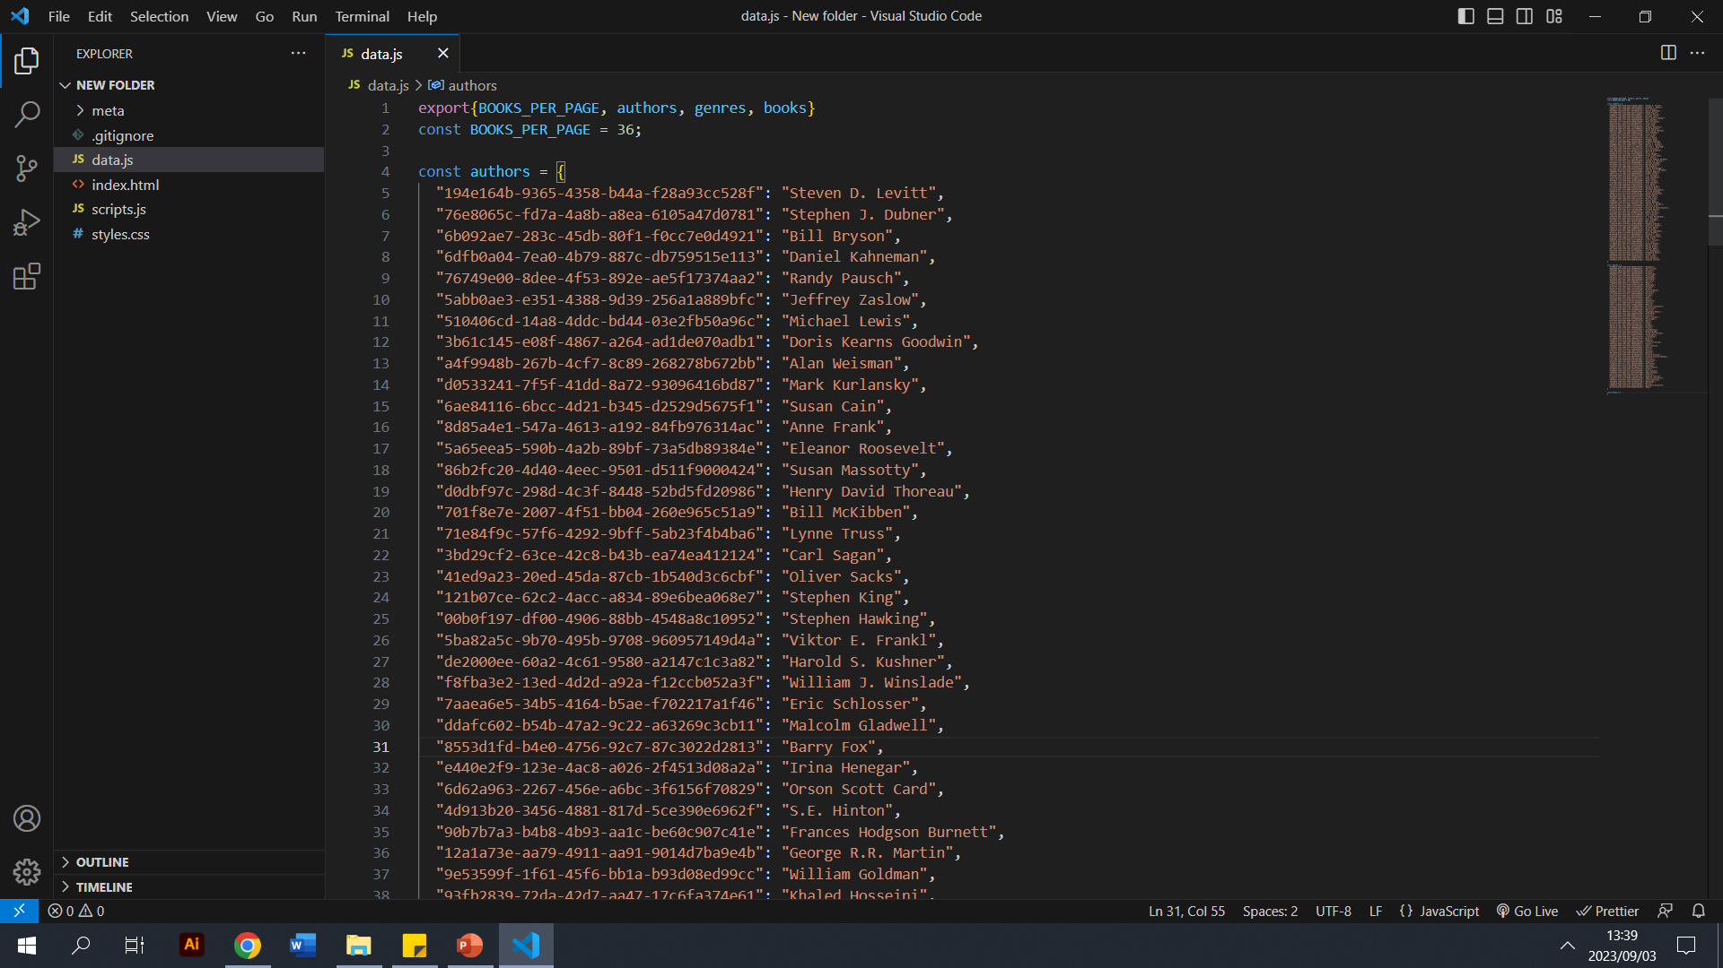
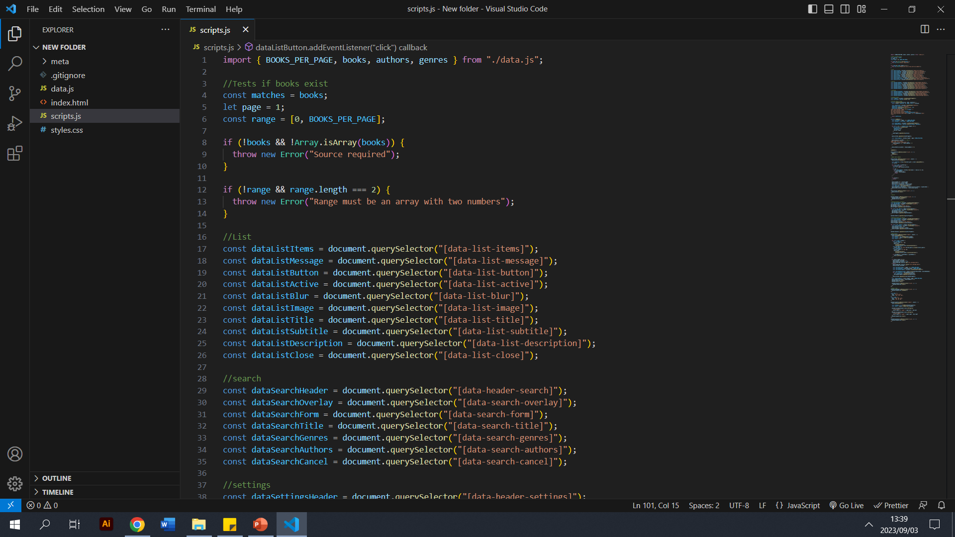
Understanding The Current Code
1. index.html:
This is the main HTML file of your web application. It serves as the entry point and provides the structure and content for the webpage. It contains the following:
HTML structure
Metadata
External Resources & Links
Layout and Content
2. style.css:
This is a Cascading Style Sheets (CSS) file that is used to define the visual styling and layout of the webpage. It contains rules that determine how elements on the page should be displayed, such as colours, fonts, spacing, positioning, and more.
3. data.js:
This file is likely used to hold data or configuration settings that are used by your application. It could be a JavaScript module that exports data objects, arrays, or other values that your application needs. It might contain information about books, genres, authors, or other data relevant to your application. This data can be used dynamically in your JavaScript code to populate content on the webpage or drive certain behaviours.
4. scripts.js:
This JavaScript file seems to contain the main scripting logic for your web application. It likely handles interactions, dynamic content updates, and user interface behaviour. The code in this file seems to deal with book previews, filtering, button clicks, event handling, and possibly more. It's essentially the "brains" of your application, making it interactive and responsive to user actions.

Slide 4
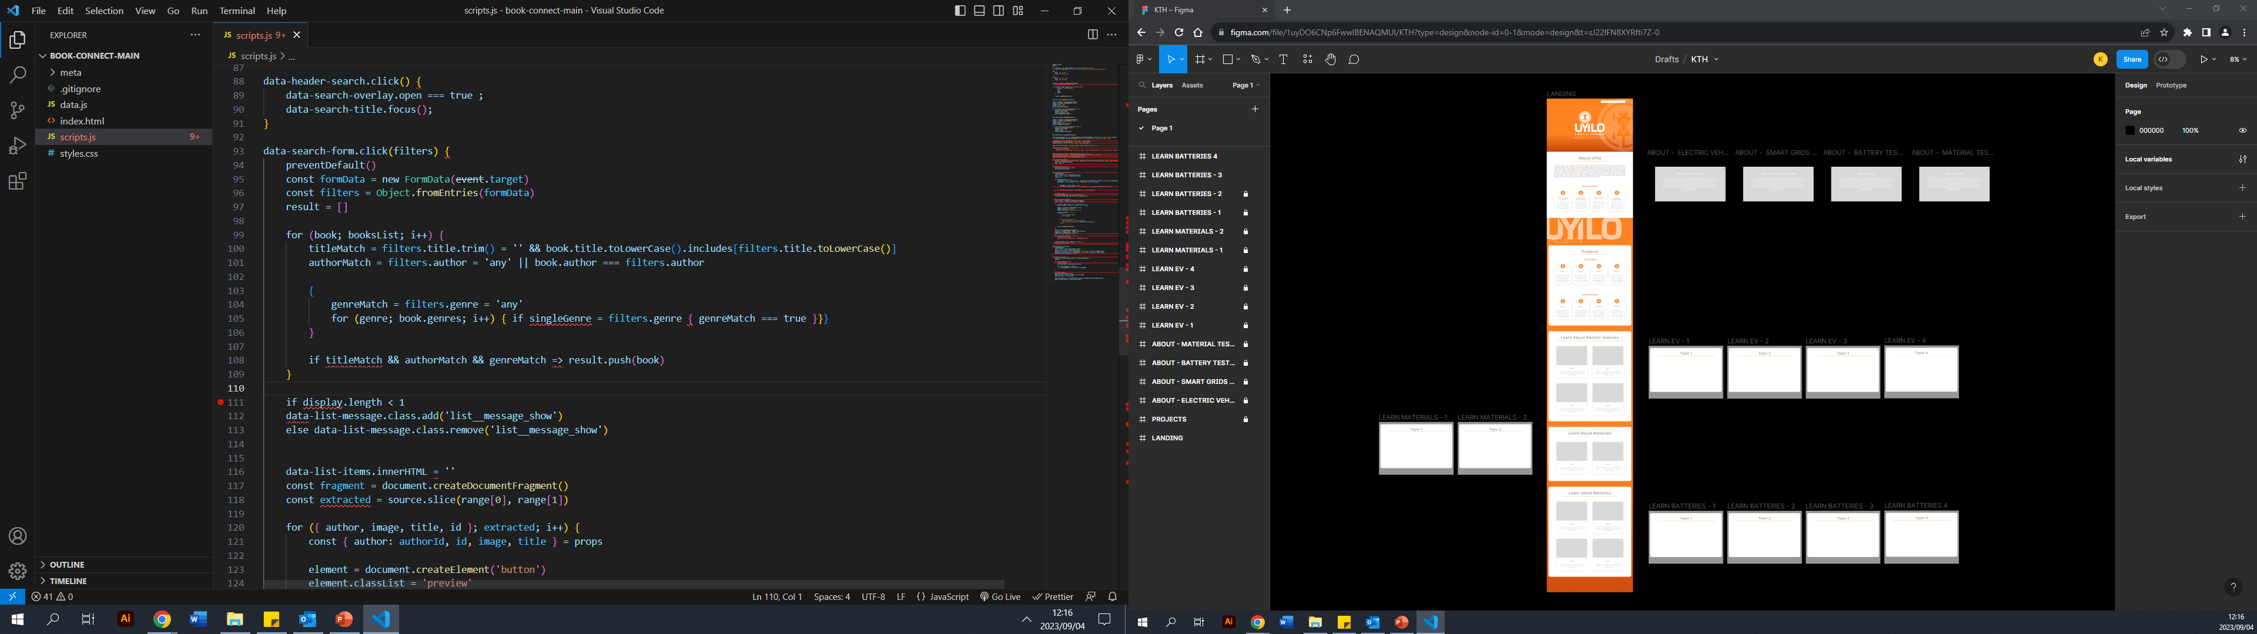
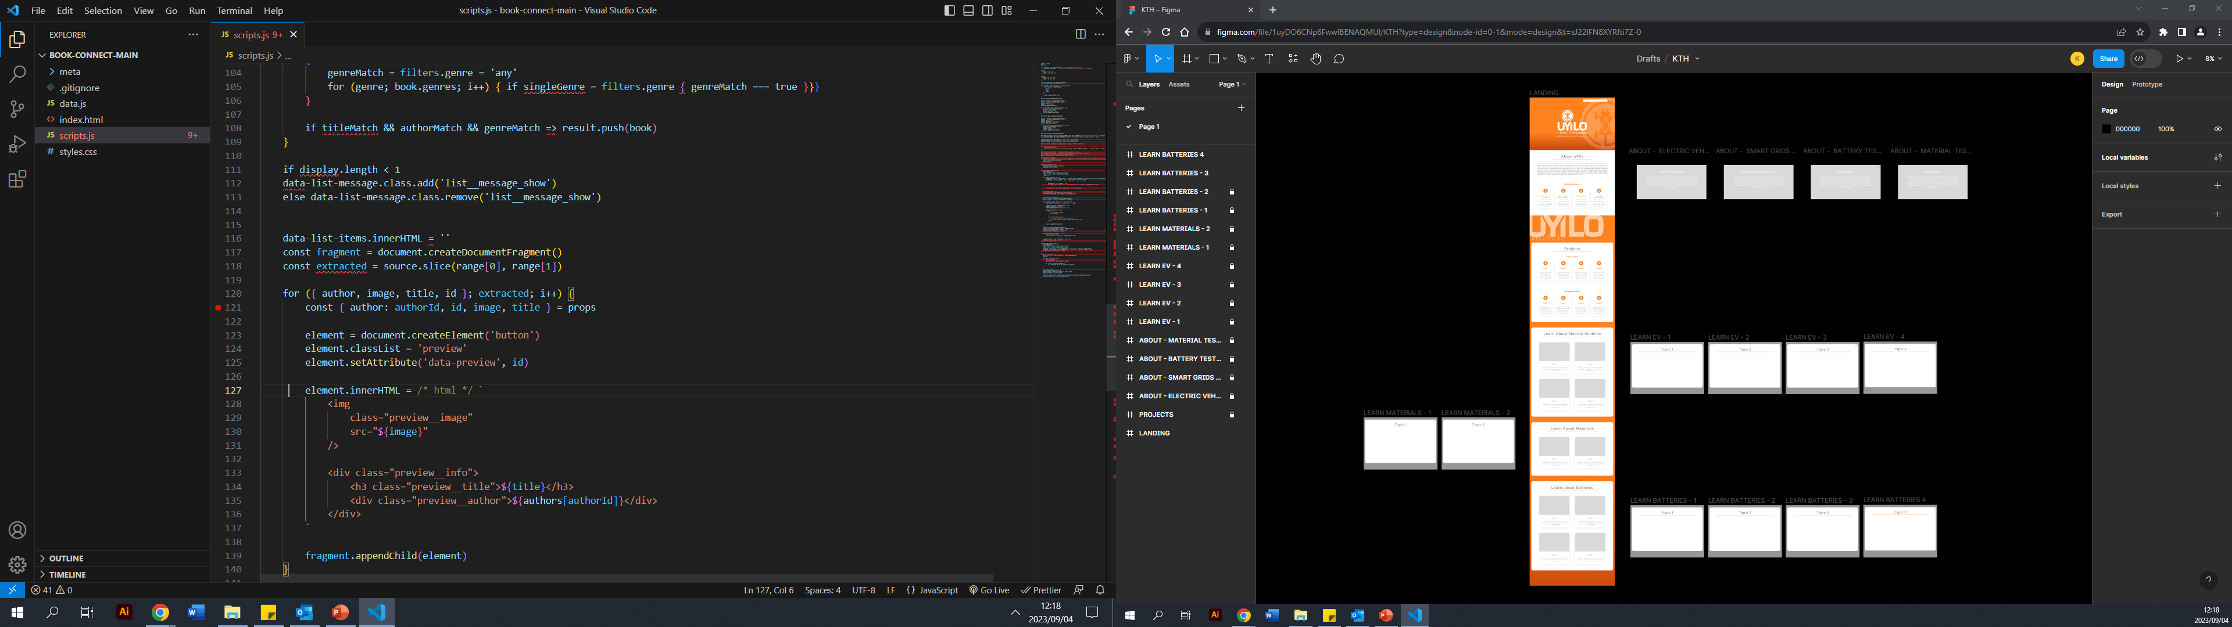


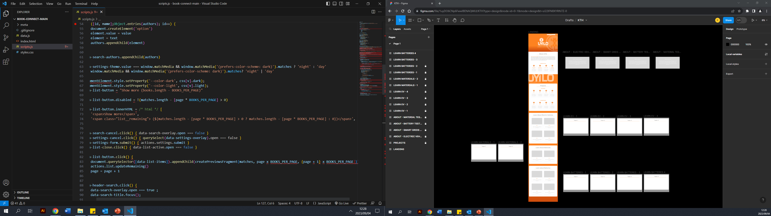
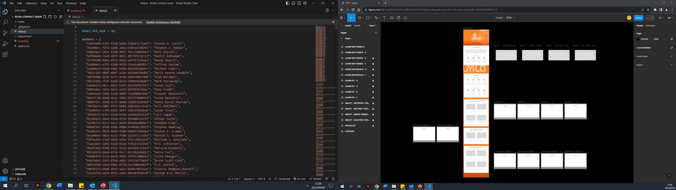
Identifying Code Issues
Syntax Errors: missing parentheses around the condition and a colon to start the block.
2. Incorrect Loop Usage: missing proper initialization, condition, and update statements.
3. Object Property Assignment: Incorrect destructuring of array.
4. Conditionals and Assignment: Incorrect usage of => and missing parenthesis.
5. String Templates: Incorrect format of string interpolation.
6. Undefined Variables: Undefined.

Slide 5
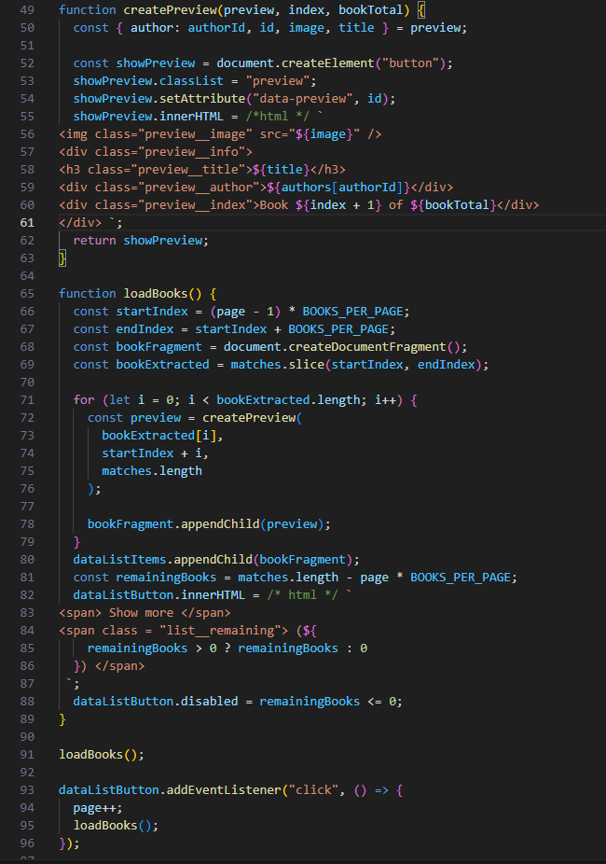
Preview Updates
. The function ‘createPreview’ takes three parameters: preview, index and booktotal.
The ‘Loadbooks’ functon loads and displays books based on the page by calculating the startindex and the endindex to slice the ‘matches’ array to select the books for the current page.
The show more buttons shows the number of books left and if there are no remaining books the button is disabled
4. The page is initialised by calling the Loadbooks. When the button is clicked the loadbooks loads again for the next batch of books.
Summary
Books are displayed in batches and loads in baches when the show more button is clicked.

Slide 6
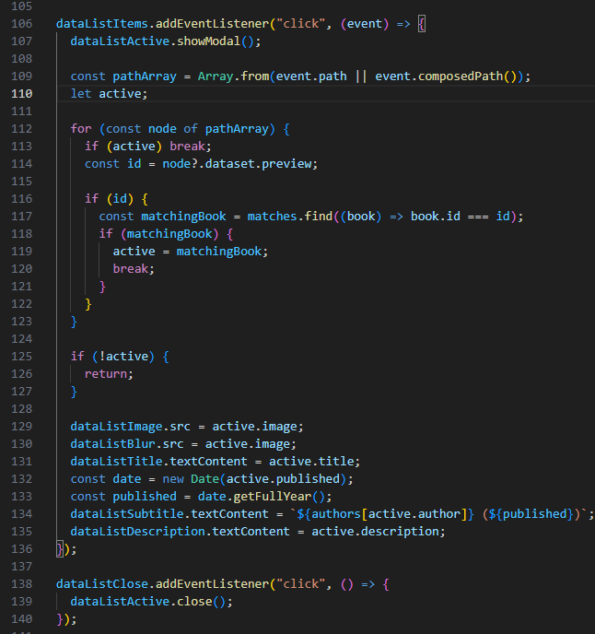
Book Summary Updates
Modal is opened upon button being clicked using an eventlistener.
Variable ‘active’ is declared which is used to store information about the clicked item.
A loop is used to check if each element has a ‘data-preview’ attribute. If an attribute is found, a matching item is found using the id property of array items. When the item is found, it is assigned to the active variable and breaks the loop. If there is no match, the code the returns indicating that there is no further action.
When a matching item has been found, the following updates take place in the modal: Image, Title, authors name, book info and publication year are set to the active items.
Using an eventlistener if the button is clicked the modal is set to close.
Summary
Updates about the clicked item are made to the modal. These updates include the Book Summary, publication year, author name, book image and book title.

Slide 7
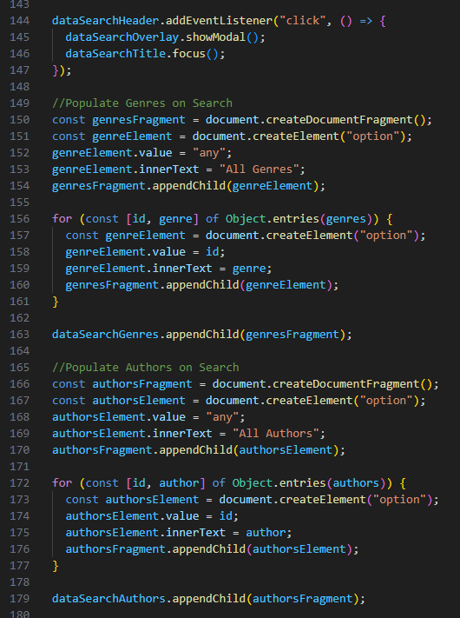
Filter Updates
Click event listener is added to the ‘datasearchheader’ element. When clicked, it triggers the showModal overlay and sets focus on the ‘datasearchtitle’ element so that the curosor will be placed on the input field, ready for users.
Creates a document fragment which is used to hold elements. Appends “All genres” to a genresFragment and then iterates through genres object using a loop. Inside the loop, there is an option element for the different genres and sets its value to an id and the text content to the name of the genre. The different genre options are appended to the ‘genresfragment’ which is then appended to the ‘dataSearchGenres’ element to create a dropdown select element.
Creates a document fragment which is used to hold elements. Appends “All authors” to a authorsFragment and then iterates through genres object using a loop. Inside the loop, there is an option element for the different genres and sets its value to any and the text content to the author name. The different author options are appended to the ‘authorsfragment’ which is then appended to the ‘dataSearchAuthors’ element to create a dropdown select element of the different genres
Summary
Dropdown menu’s are populated to select from a list of authors or genres.

Slide 8
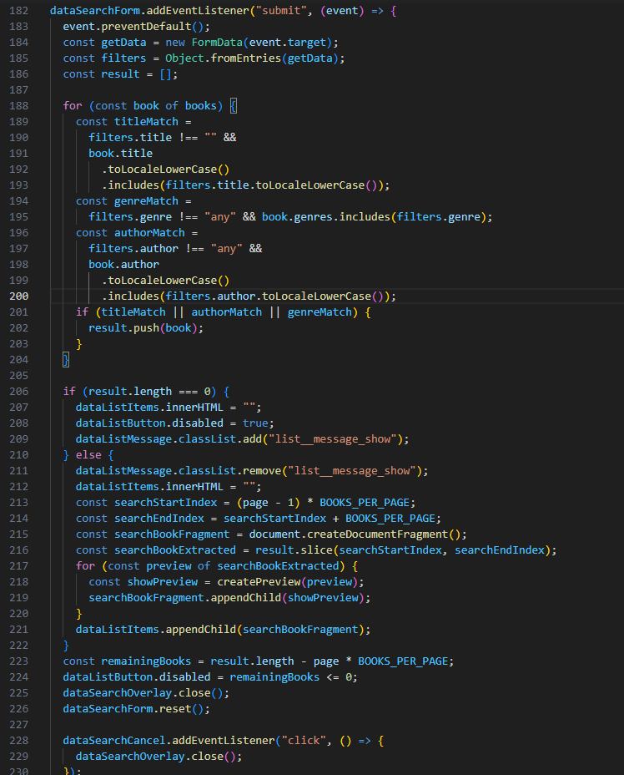
Search Updates
An eventlistener is added to the dataSearchForm so when the search is “submitted”, the call-back function is executed.
2. Creates a new form data element containing all the data submitted.
3. Converts form data into new object filters which holds the users input info.
4. Loops through array to check if each book matches search criteria given by the user. (Title, genre, author)
5. If there are no matching books the UI is updated to show a message. If there are matching books UI is updated to display books.
6. Overlay is closed
7. Cancel button resets the page.
Summary
A search function is created for a list of books based on a users inputs. It displays available books or a message if no books are available as pe the users input.

Slide 9
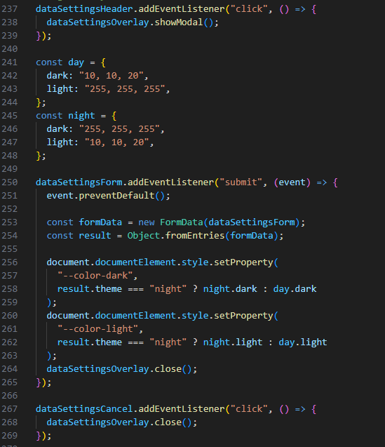
Theme Updates
An event listener is called on “dataSettingsHeader” to open the Modal for the night and day function when the button is clicked
2. Two variables “night” and “day” are defined, each with two properties “light” and “day” which are the colour schemes used for the themes.
3. Sets The two CSS variables, which are chosen depending on the “result” of which option is chosen. And the Model set to automatically close upon selecting a new theme.
4. An event listener is used to close the Model for the night and day function when the cancel button is clicked.
Summary
Header button clicks, opens the modal. Form Submission updates theme colours. Cancel button closes the modal. CSS variables define the colour scheme.

